Slide 1
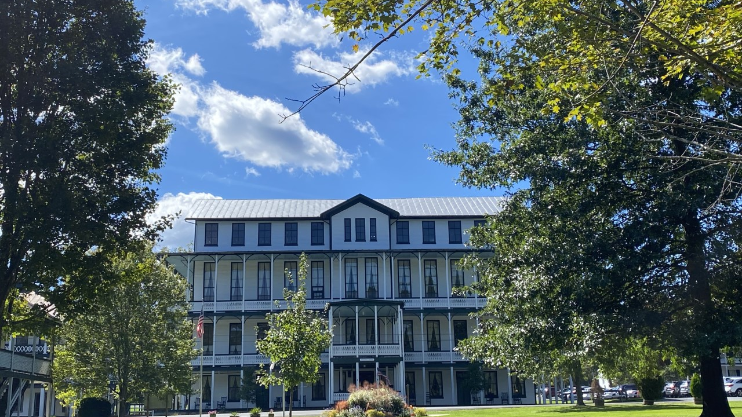
Camp Trinity @ Shrine Mont
September 23-25, 2022

Slide 2
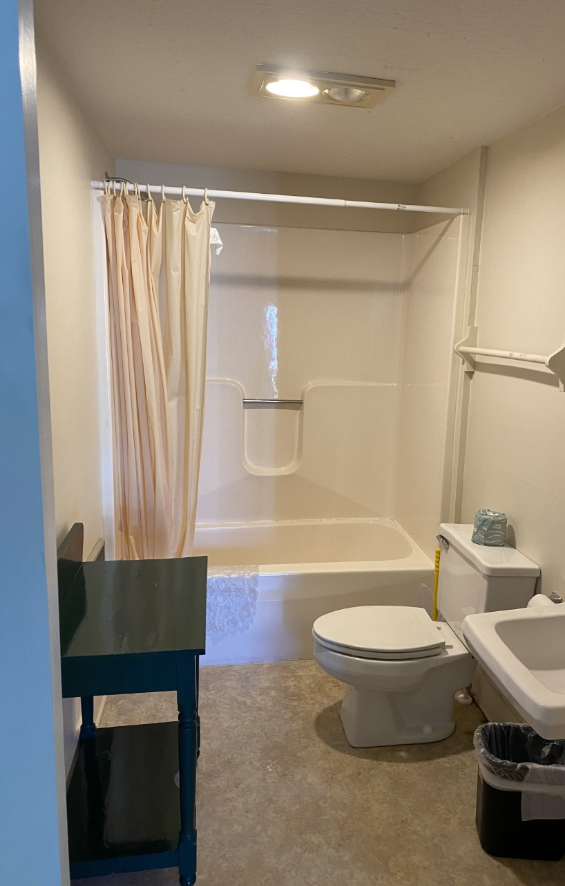
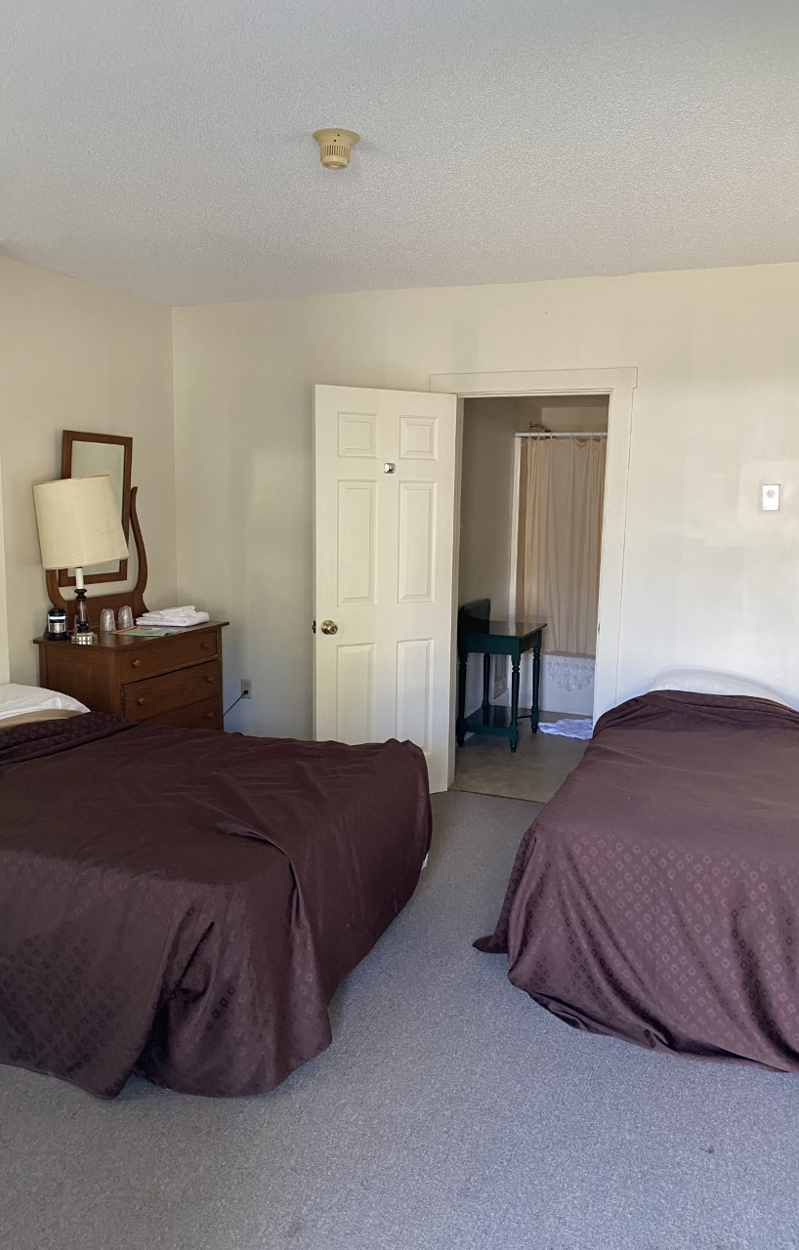
Accommodations-
Families will have private rooms that accommodate their needs with dining either at the picnic tables or dining hall.

Slide 3
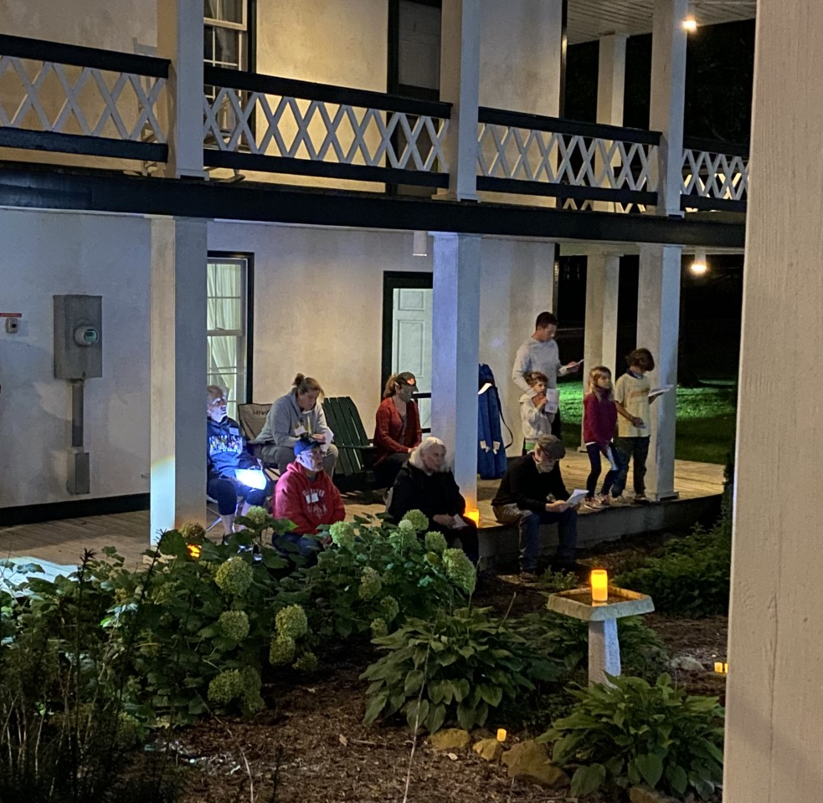
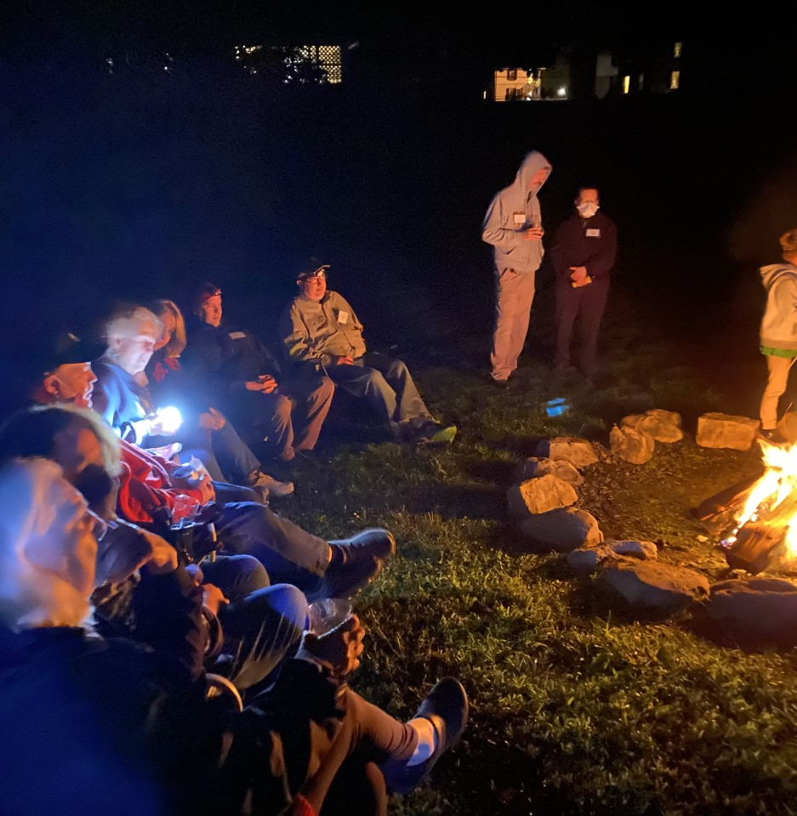
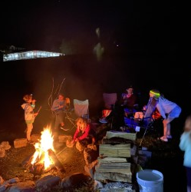
Activities for everyone!!
Bonfires, singing, celebrating, talking, exploring, Bingo, and faith opportunities around, you name it and we have fun

Slide 4
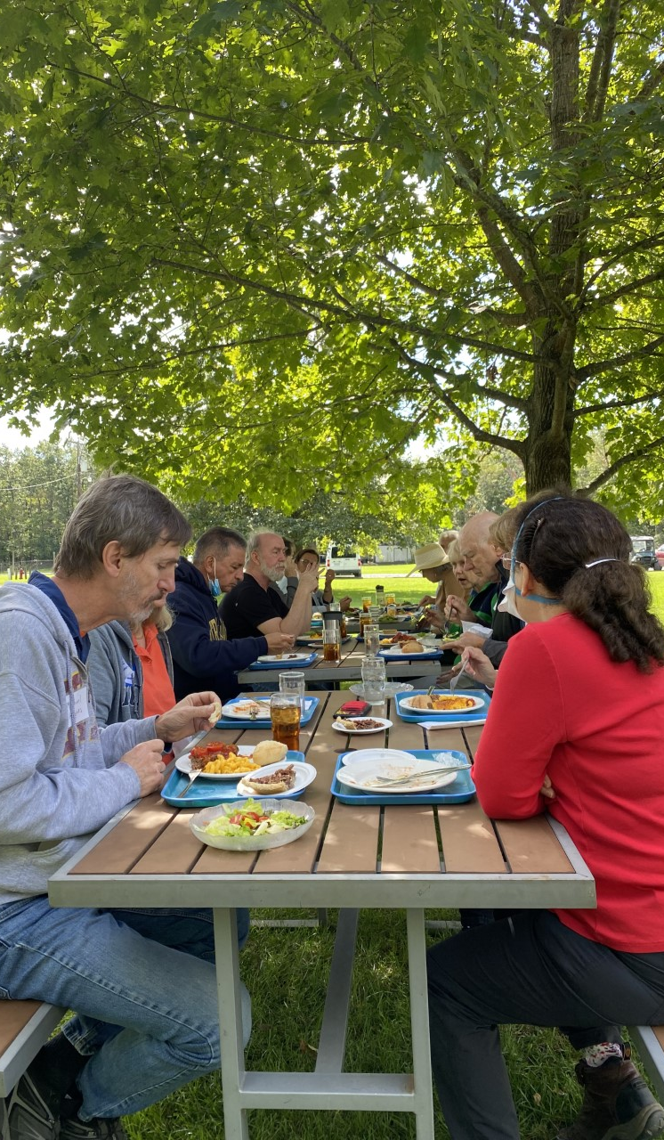

Slide 5
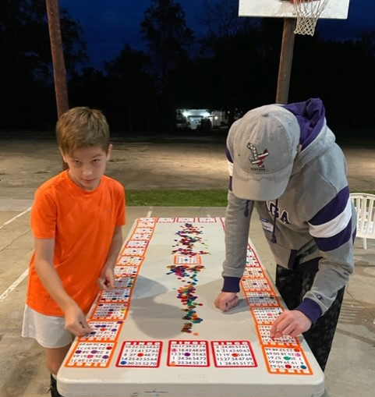
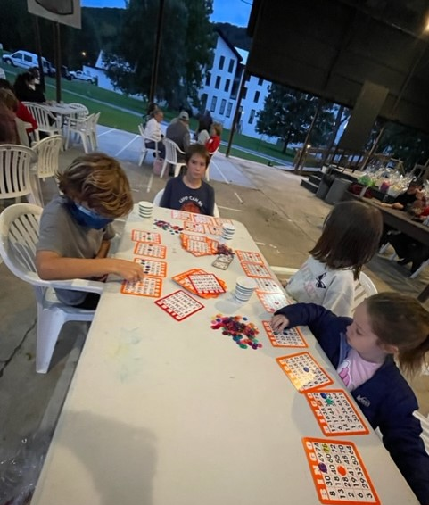
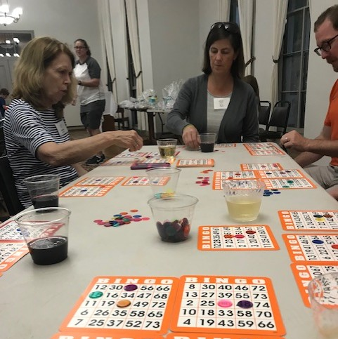
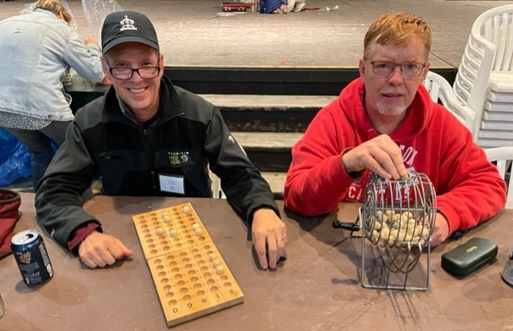
Bingo & Fun
B4 and after
So many more jokes and funny saying that the laughter is almost contagious and the giggles last for hours

Slide 6
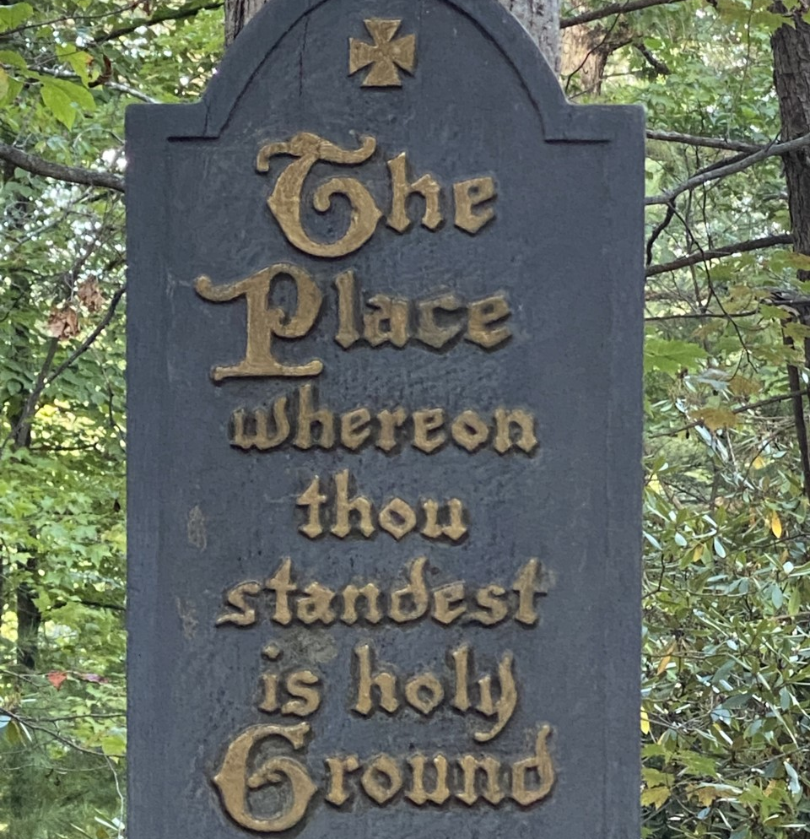
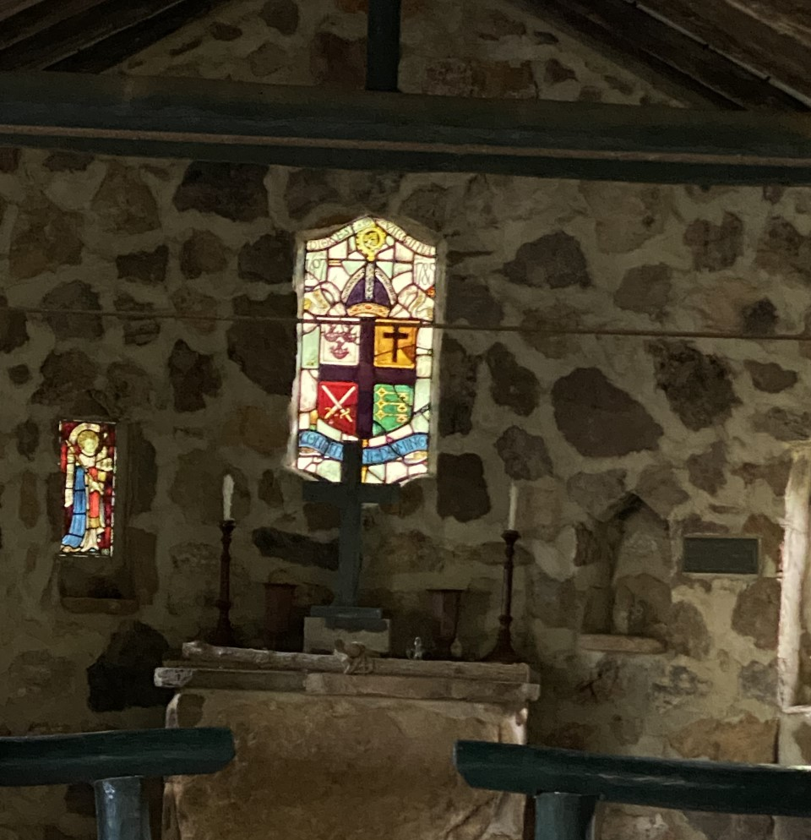
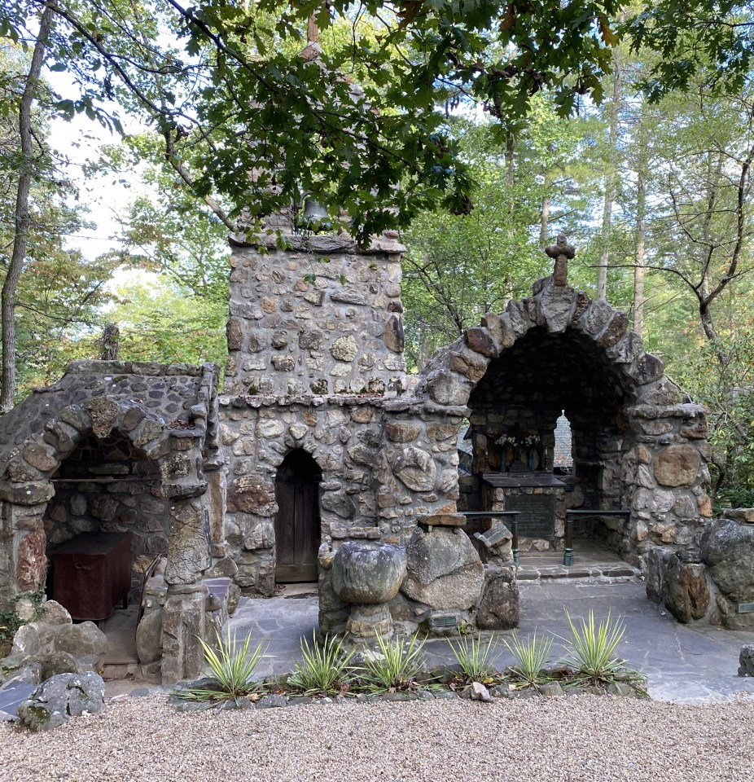
The Grace of God Around Us

Slide 7
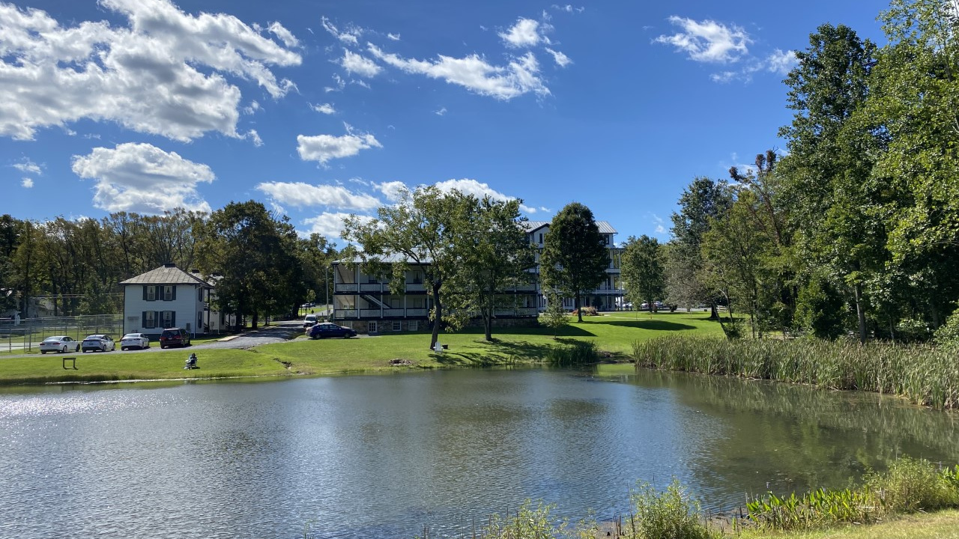
Shrine Mont and her Beauty.

Slide 8
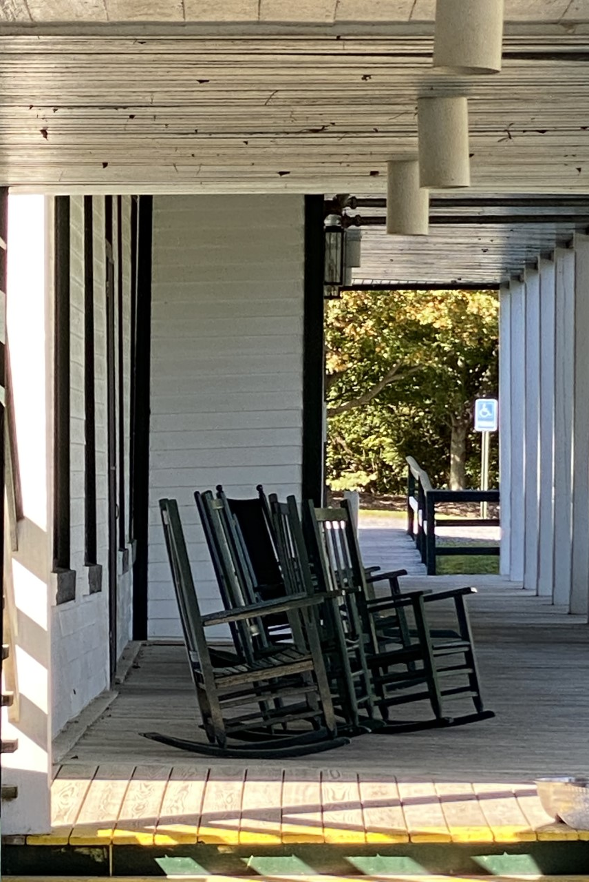
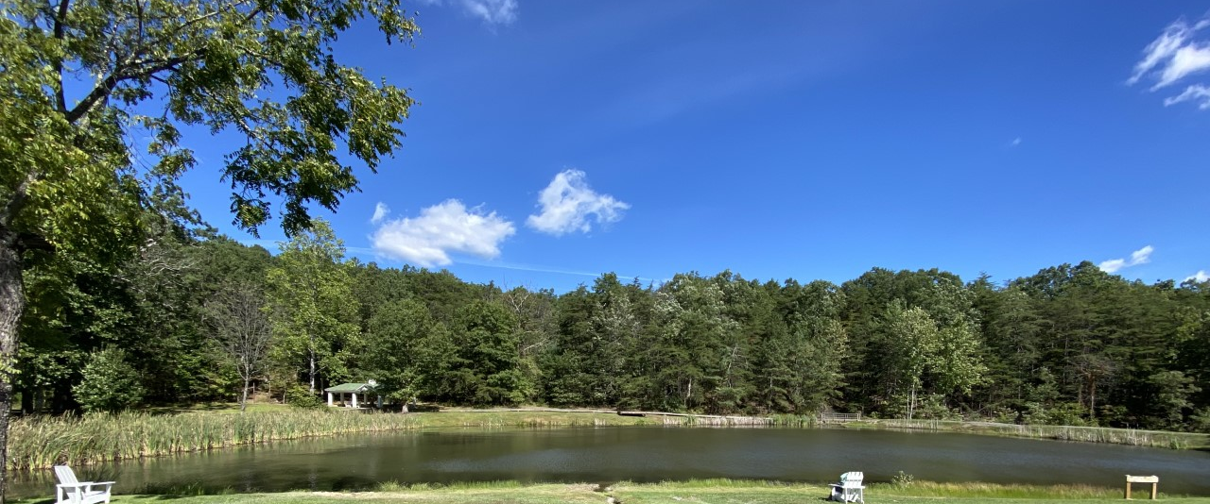
Take time to Breathe Deeply & Relax

Slide 9
Her Light Shines Bright Day & Night

